Slide 1

2025 NM FTC KICKOFF

Slide 2
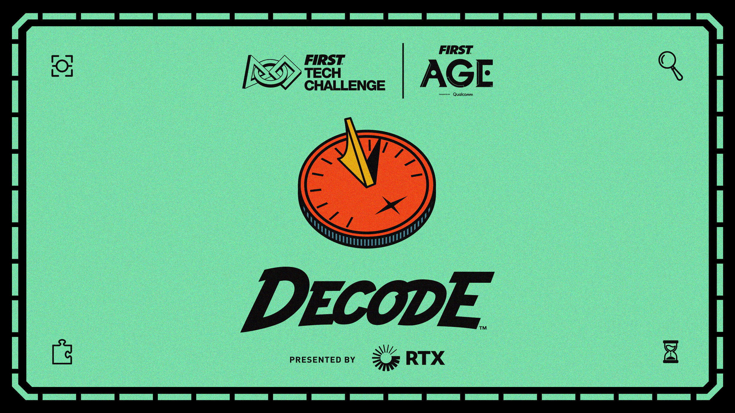

Slide 3
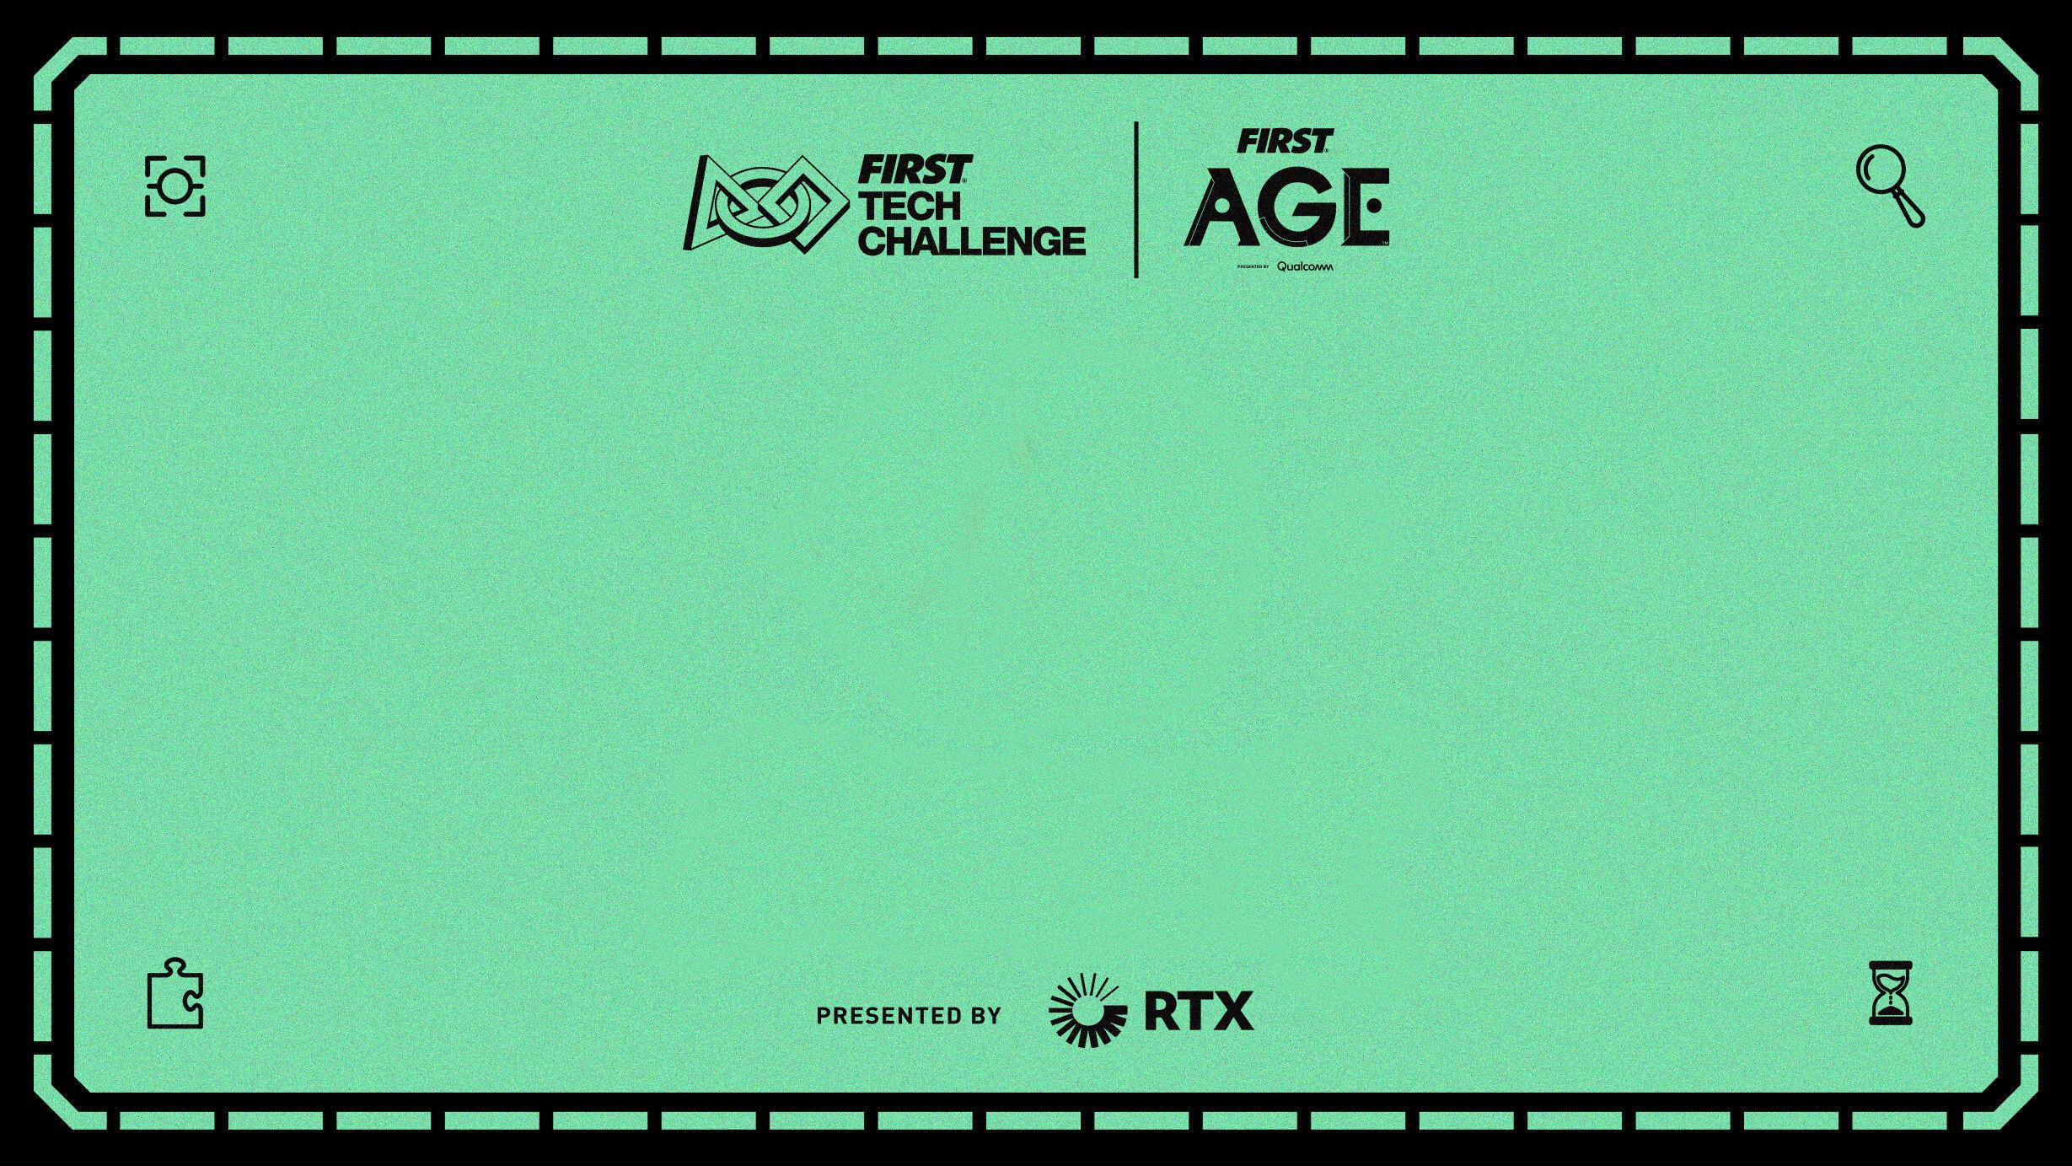
Odometry & Frameworks
Presented by Enigma #16265
2025 NM FTC KICKOFF
Sept 6, 2025

Slide 4
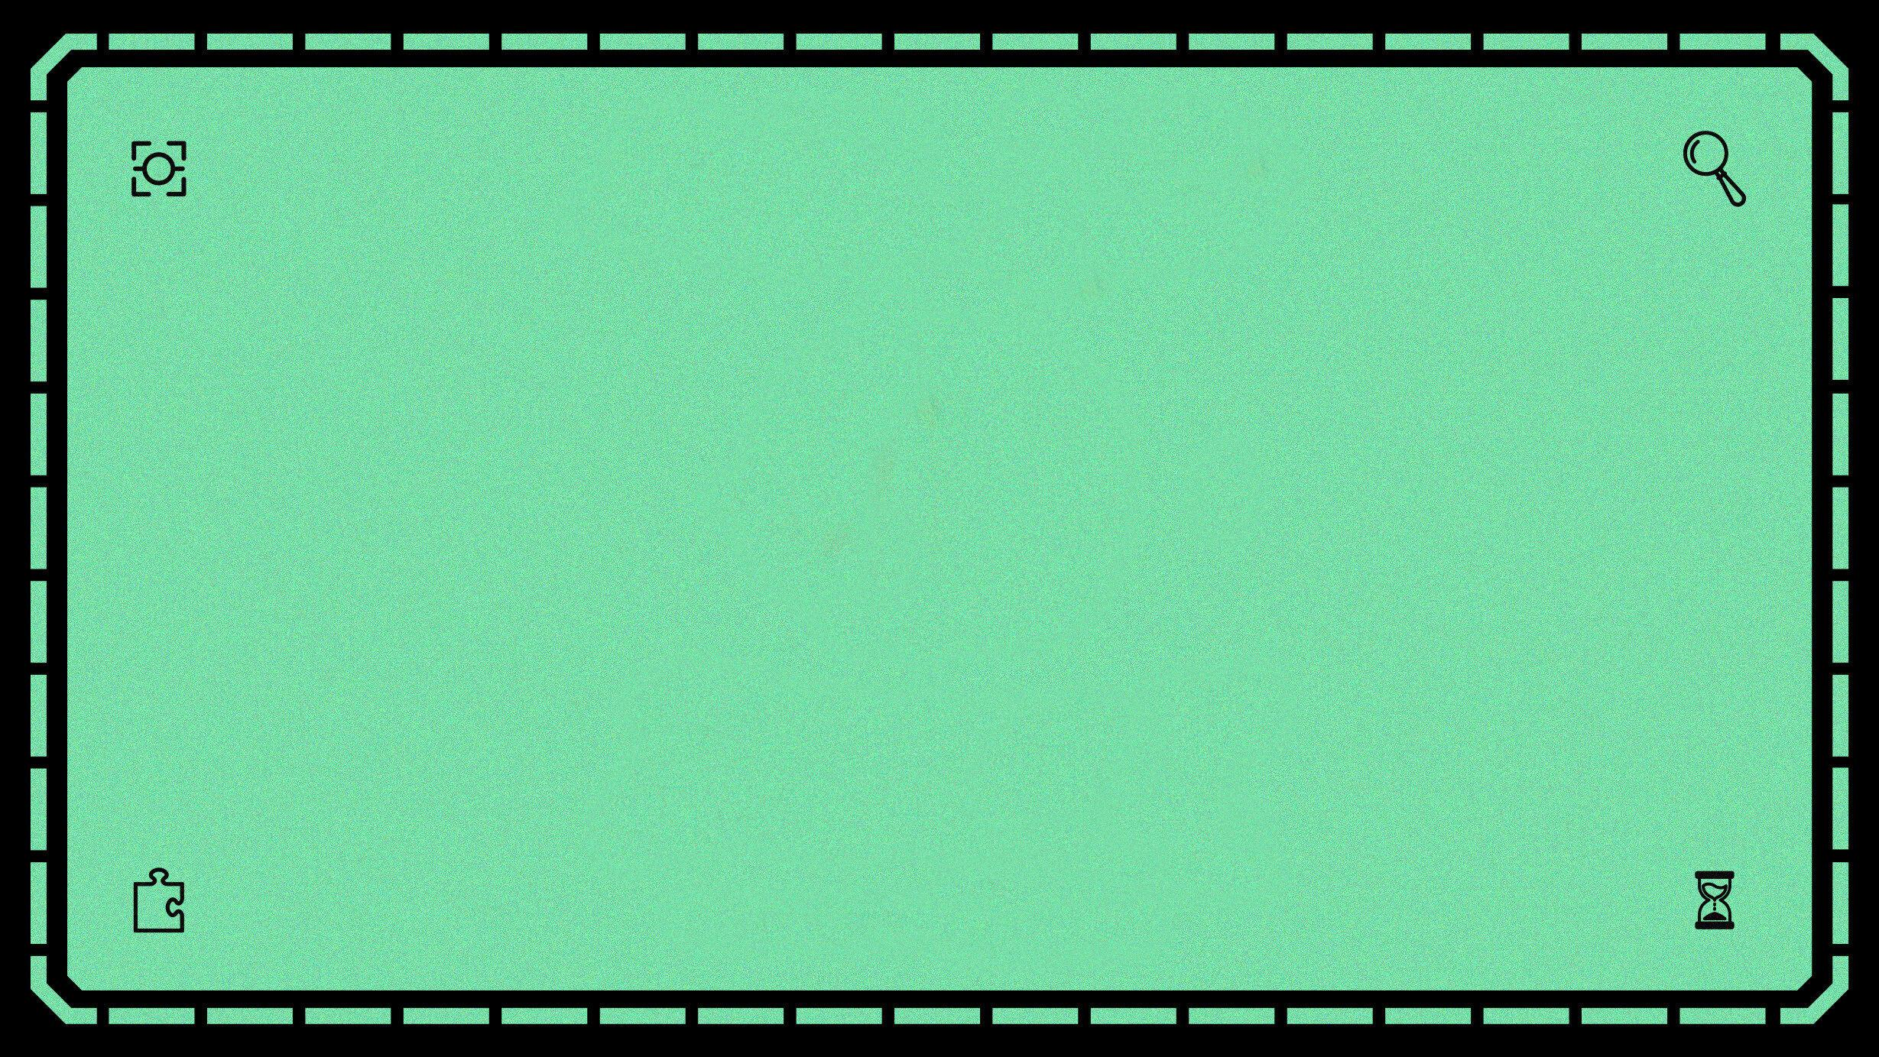
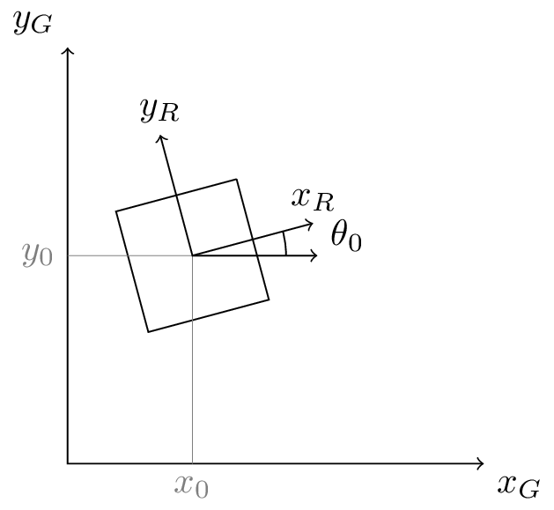

What is Odometry?
Odometry is a method of estimating a robot's or vehicle's position and orientation over time by using motion sensors, such as rotary encoders or cameras, to measure incremental changes in movement. In the case of wheeled robots, it tracks the number of wheel rotations to infer distance traveled, but it is prone to accumulating errors from wheel slippage, uneven surfaces, and imperfect system modeling.
Deeper explanation of Odometry
(lots of math)

Slide 5
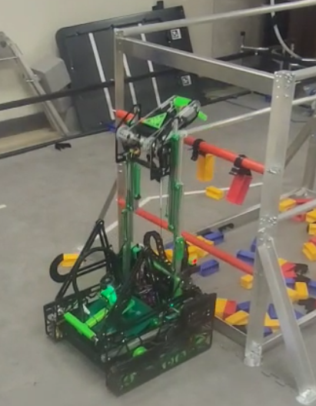
Why odometry is crucial for FTC robots
Precise Autonomous Navigation: During the autonomous period, robots must navigate the field to perform tasks without driver input. Odometry allows them to calculate their exact position, enabling programmed paths and precise movements to target specific locations on the field.
Dealing with Drive System Inaccuracies: Many popular FTC drive systems, such as Mecanum drives, can experience significant slippage or drift. Odometry provides an external method to measure the robot's actual movement, correcting for these inaccuracies and improving positioning.
Complex Task Execution: To successfully complete complex tasks, a robot needs to know its precise location and orientation. Odometry helps robots understand their position relative to the starting point, which is vital for tasks requiring accurate alignment or movement to specific game objects.
Improved Reliability and Performance: By providing a more accurate estimation of the robot's position, odometry leads to greater reliability in autonomous programs and overall better performance on the field.

Slide 6

Odometry Frameworks Explained
Drive Encoder Localization
This is the most basic odometry method, where the built-in encoders on the robot's drive motors are used to estimate the robot's movement.
How it works: By measuring the rotation of the motor shafts, software can calculate how far each wheel has turned and translate that into the robot's estimated position (x),(y), and heading (theta).
Pros:
  Simple and easy to set up, as it uses existing motor hardware.
  Requires no additional components.
Cons:
  Inaccuracy: Highly susceptible to wheel slippage, especially with mecanum wheels or during high-acceleration turns.
  Drifting: Inconsistent traction can cause the robot's position estimate to drift over time, which can lead to significant errors in autonomous mode.
Autonomous Programming Using Encoders in Blocks

Slide 7
Odometry Frameworks Continued
Dead Wheel Odometry (Odometry Pods)
This is a more accurate and popular method that uses dedicated, unpowered (dead) wheels with their own encoders to track the robot's movement independently of the main drive wheels.
How it works:
Small omni wheels are mounted on the robot (typically 2 or 3) and kept in constant contact with the field tiles, often using a sprung or swingarm assembly.
As the robot moves, the omni wheels spin and their attached encoders precisely measure the distance traveled.
This data is fed into a kinematic model to accurately calculate the robot's position and heading.
Pros:
High accuracy: Significantly reduces errors caused by wheel slippage from the drive train.
Reliable tracking: Designed to maintain ground contact, resulting in a more consistent position estimate.
Improved mecanum performance: Ideal for mecanum drive bases that are prone to slippage.
Cons:
Hardware challenge: Requires more complex mechanical design and assembly.
Cost and complexity: Involves additional components like odometry pods and encoders.

Slide 8
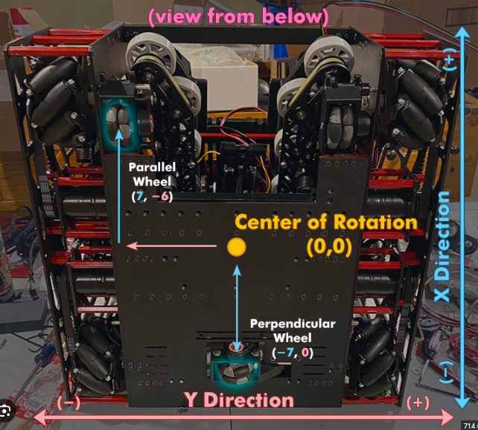
Odometry Pods Continued
2 Wheel Odometry
  Requires an IMU, usually the gobilda pinpoint, or rev control hub IMU
  Takes up less space and is lighter weight
3 Wheel Odometry
  Takes up more space and is heavier
  Doesn’t require any additional sensors
  Less flexibility in placement of odometry pods
Odometry Design Considerations
  Position of pods on the robot doesn’t matter, as long as you know the distance from the center of rotation
  At least one odometry pod facing each direction is required
  Odometry pods take up considerable space which should be taken into consideration during design

Slide 9

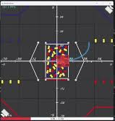
Path Planning
Roadrunner
  Motion planning library
  Three Primary Functions
    Localization
    Trajectory Generation
    Control
  Tuning process is required, and needs to be retuned if significant changes to the robot are made
Meep Meep Visualizer
  Trajectory Visualization: Meep Meep draws out the paths your robot will take on a visual representation of the FTC field.
  Timeline Scrubbing: You can play, pause, and scrub through the timeline of your autonomous path to see how it unfolds.
  Integration: Meep Meep runs directly within Android Studio, allowing it to be co-located with your team's existing FTC season code.
  Path Exporting: You can export the visualized paths to an image format for use in portfolios or presentations.
Roadrunner Documentation

Slide 10

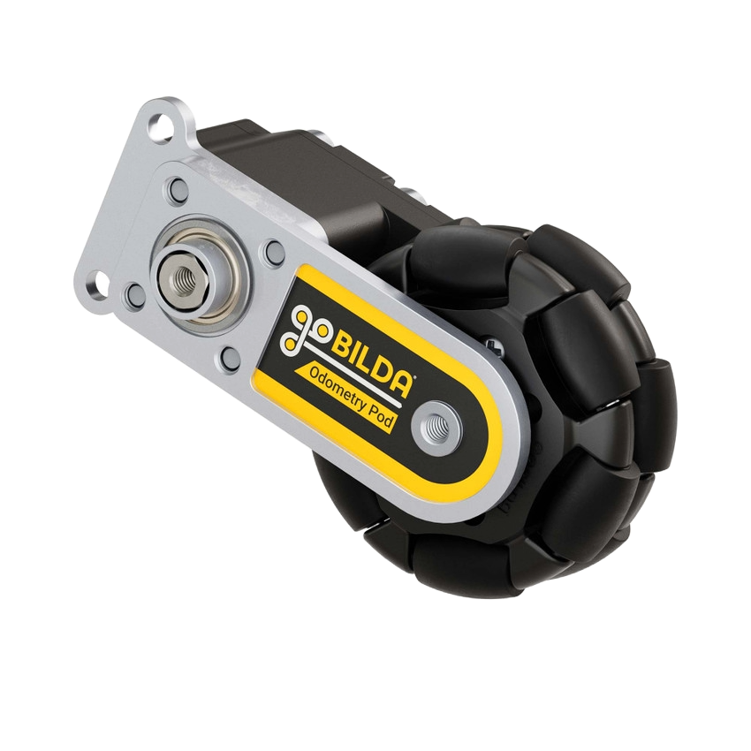
Designing & Building Basics
Odometry Systems
  Gobilda
    Four bar odometry arm
    Swing arm odometry
    Gobilda Pinpoint - external IMU, more accurate than REV IMU but not needed
    Personally our most recommended, as it is the most reliable, and has the most support and resources available for it
  Custom Odometry
    Custom Odometry designs such as OpenOdometry by team 18219, LoonyOdo, and other open source options are available
    Can often be made cheaper than off the shelf odometry, and can be designed to fit your specific needs
Gobilda Odometry

Slide 11
THANK YOU!
If you have questions, please reach out through our coach at:
russmc@adisteam.org

